Slide 1
Reproducible Research using IPython Interactive Publications
Robin Scheibler and Amir Hesam Salavati

Slide 2
Outline
What?
Why?
How?

Slide 3
What

Slide 4
Reproducible research
“The term reproducible research refers to the idea that the ultimate product of academic research is the paper along with the full computational environment used to produce the results in the paper such as the code, data, etc. that can be used to reproduce the results and create new work based on the research”. [wikipedia]

Slide 5
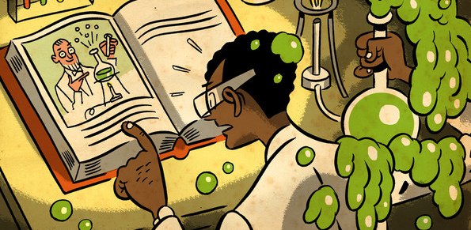
Verifiability
image from economist

Slide 6
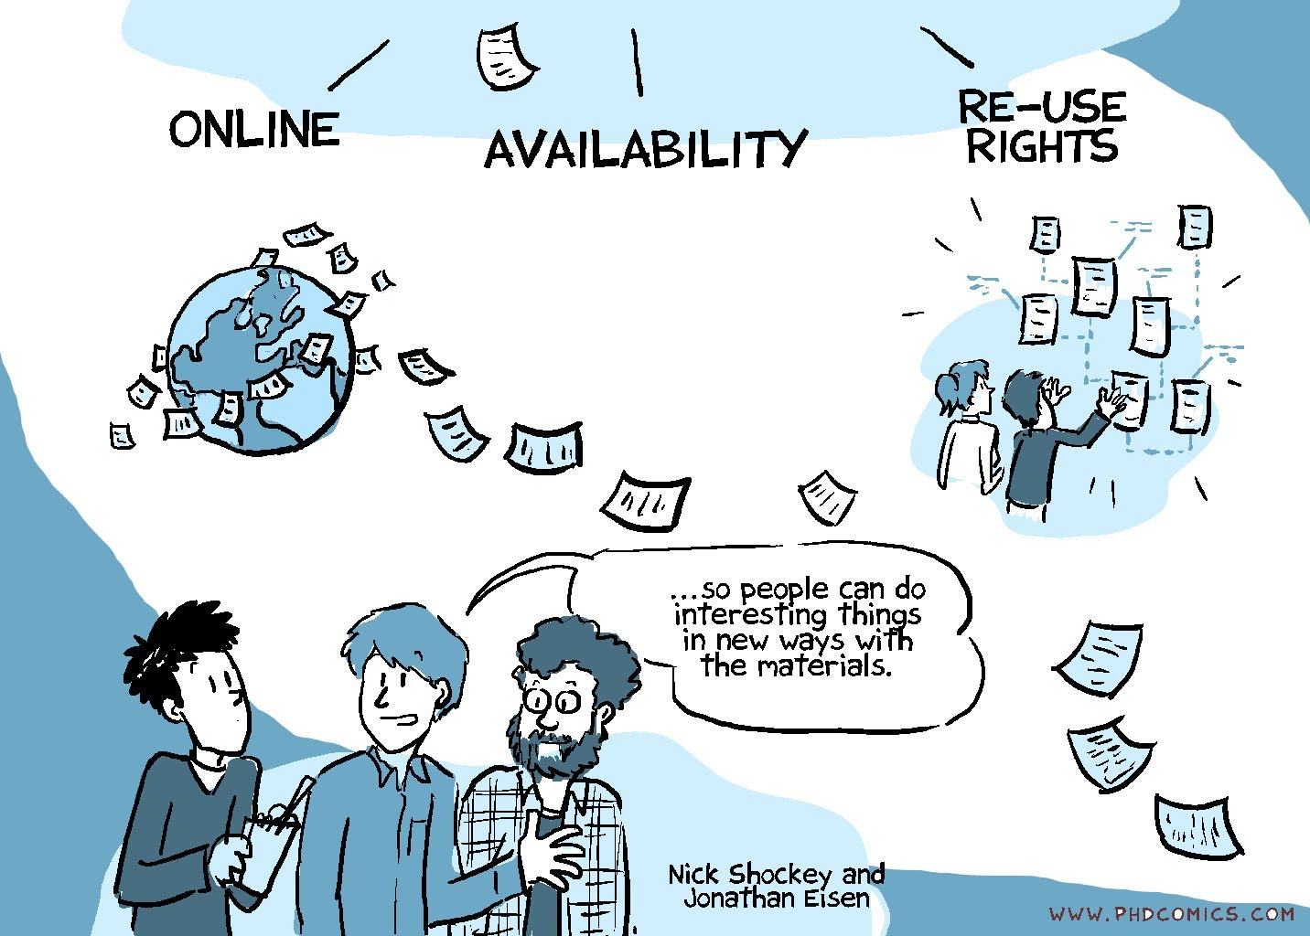
Advancement of Science
image from PhD Comics

Slide 7
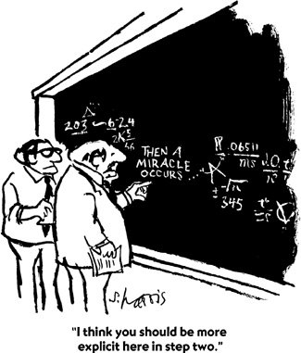
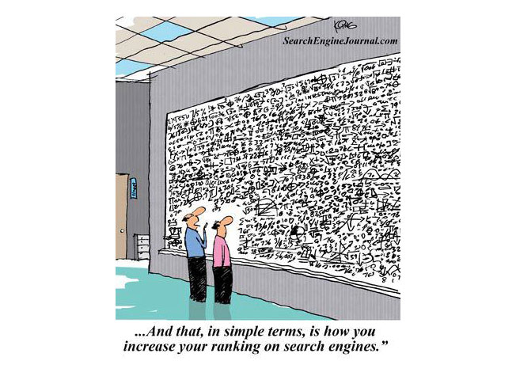

Different Levels in Different Fields
image from SIAM
image from FoE.org

Slide 8
Math
Clear theorems
Complete proofs
image from SIAM

Slide 9
Computational Sciences
Clear theorems
Complete proofs
Algorithm
Code
image from SIAM

Slide 10
Life Scientists
Detailed method
Lab Protocols
Code
Data
image from FoE.org

Slide 11
It Is Not Happening!

Slide 12
It Is Not Happening!
In 2012, a survey done for Nature found that
47 out of 53 medical research papers were irreproducible
Begley, C. G.; Ellis, L. M. (2012). "Drug development: Raise standards for preclinical cancer research". Nature 483 (7391): 531–533.

Slide 13
It Is Not Happening!
In another study in 2009,
10(+6) out of 18 bioinformatic papers could not be reproduced completely
Ioannidis JPA, Allison DB, Ball CA, et al. Repeatability of published microarray gene expression analyses. Nat Genet 2009;41(2):149–55

Slide 14
It Is Not Happening!
In a study on the 134 papers of "IEEE Transactions on Image Processing" in 2004, it was found that
Less than 9% of papers share their code
Vandewalle, Patrick, Jelena Kovacevic, and Martin Vetterli. "Reproducible research in signal processing." Signal Processing Magazine, IEEE 26.3 (2009): 37-47.

Slide 15
Why

Slide 16

Why not?
For the sake of science
and our inner scientist

Slide 17
It increases visibility
Reproducibility involves some effort but

Slide 18
Study 1: Effect of Sharing Data
In a study in 2007 on microarray DNA research publications,
Papers with shared data were cited about 70% more frequently.
85 papers were studies
41 shared their data
Those 41 took 85% of the aggregate citations
Piwowar, H. a et al. Sharing detailed research data is associated with increased citation rate. PloS one. 2, (2007), 308.

Slide 19
Study 1: Effect of Sharing Data
Piwowar, H. a et al. Sharing detailed research data is associated with increased citation rate. PloS one. 2, (2007), 308.

Slide 20
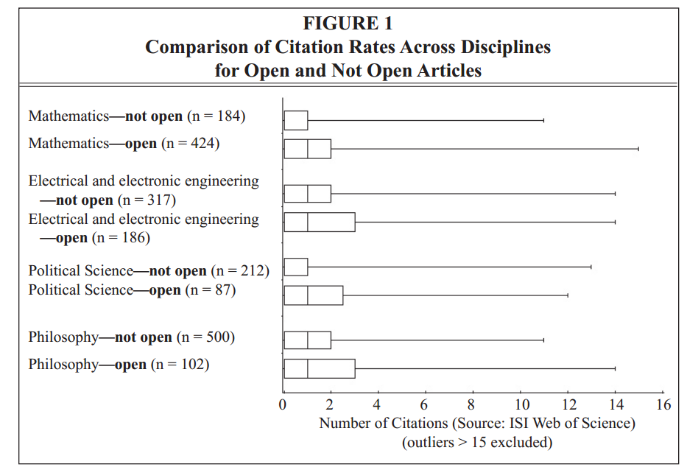
Study 2: Effect of Open Access
Antelman, Kristin. "Do open-access articles have a greater research impact?." College & research libraries 65.5 (2004): 372-382.

Slide 21
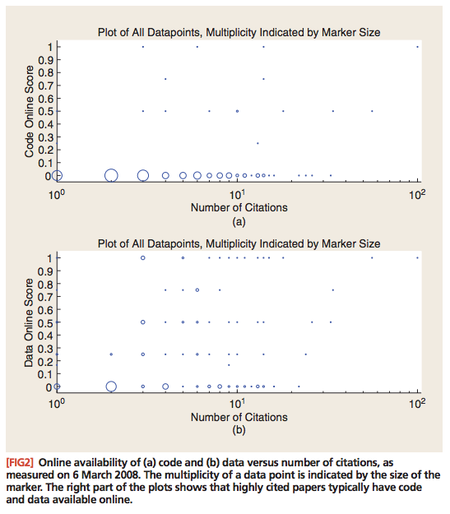
Study 3: Effect of Reproducibility
Vandewalle, Patrick, Jelena Kovacevic, and Martin Vetterli. "Reproducible research in signal processing." Signal Processing Magazine, IEEE 26.3 (2009): 37-47.

Slide 22
Sharing Data Gives You Credit
Gathering data involves a lot of effort but

Slide 23
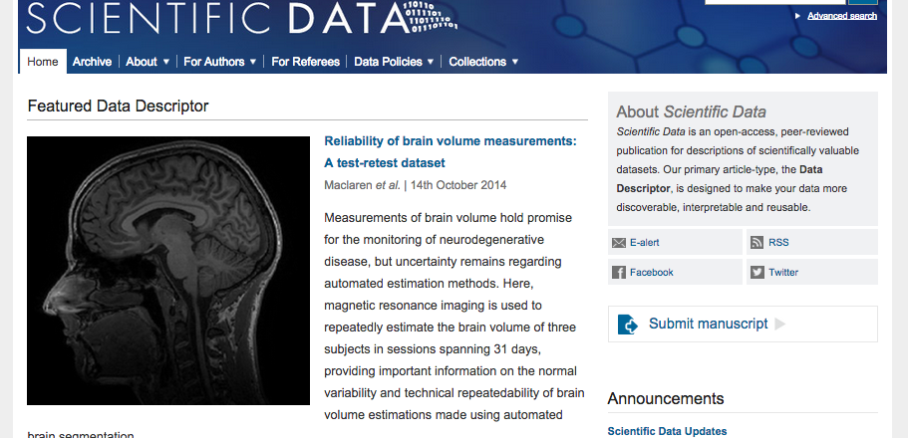
A Changing Trend
A journal for sharing data

Slide 24



A Changing Trend
More and more journals require availability of data/code
A recent study shows an increase of
16% in the number of data policies
30% increase in code policies
Stodden, Victoria, Peixuan Guo, and Zhaokun Ma. "Toward reproducible computational research: an empirical analysis of data and code policy adoption by journals." PloS one 8.6 (2013): e67111.

Slide 25
It Might Result in Fruitful Collaborations
Sharing code might result in loosing competitive advantage, but

Slide 26

Collaboration in Very Hard Problems
Polymath Case
Gowers, Timothy, and Michael Nielsen. "Massively collaborative mathematics." Nature 461.7266 (2009): 879-881.

Slide 27
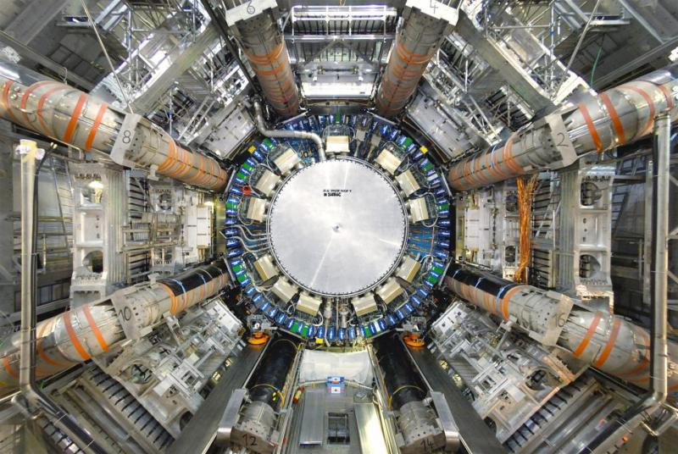
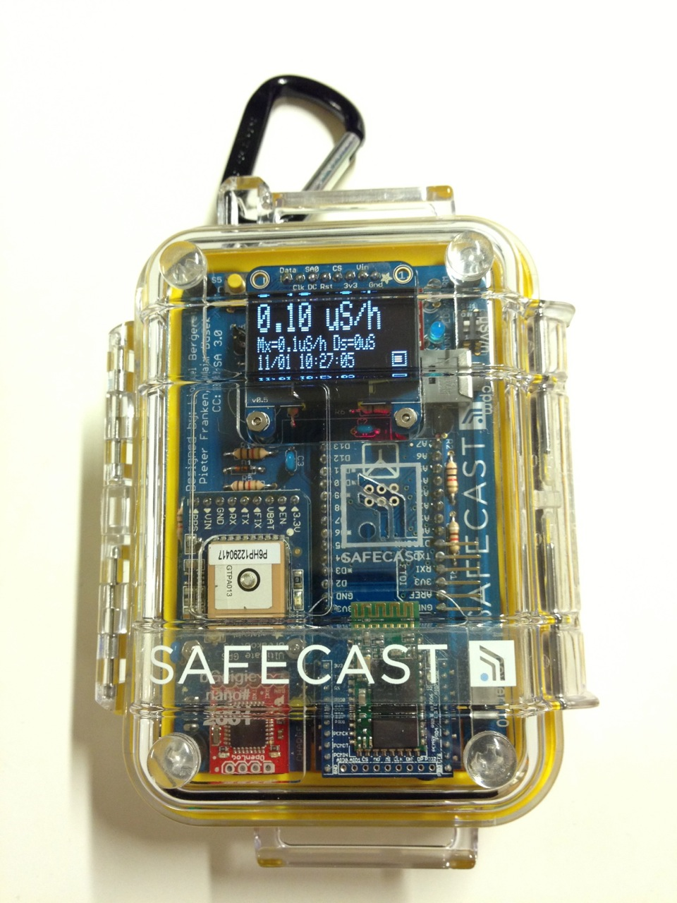
Collaboration in Very Large Problems
CERN ATLAS Project
Citizen Science

Slide 28
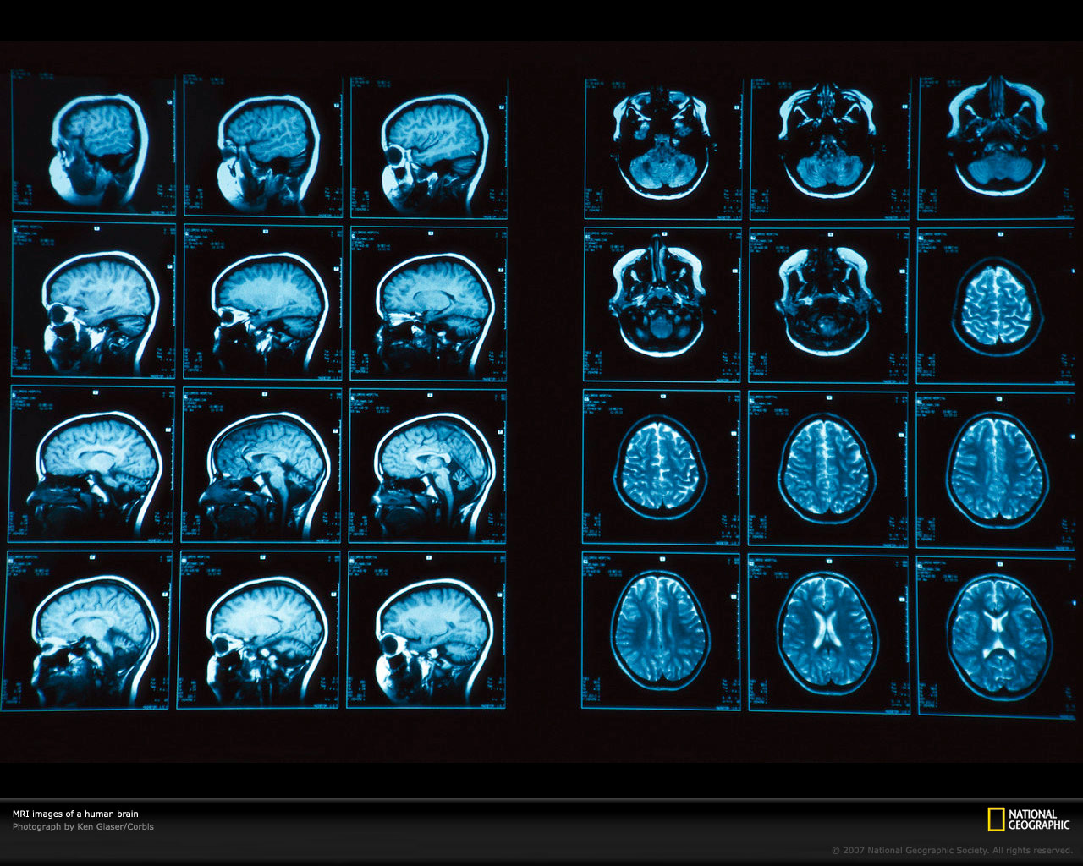
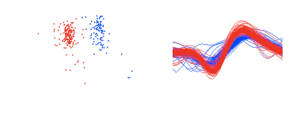
Collaboration in Very “Wide” Problems
Biomedical Image Processing
Spike Sorting
In general, all inter-disciplinary fields

Slide 29
How

Slide 30
Reproducible Documents
Complete list of steps and assumptions for proofs supplementary materials
Step-by-step algorithms
Simulation scenario Platform, version, etc.

Slide 31
Reproducible Code
Different states of the code when sharing
As is!
Reproduces results with 1 click. on a similar machine with the same software versions
With explanatory comments
That can be used with different data
Works as a package/toolbox

Slide 32
Reproducibility at LCAV

Slide 33
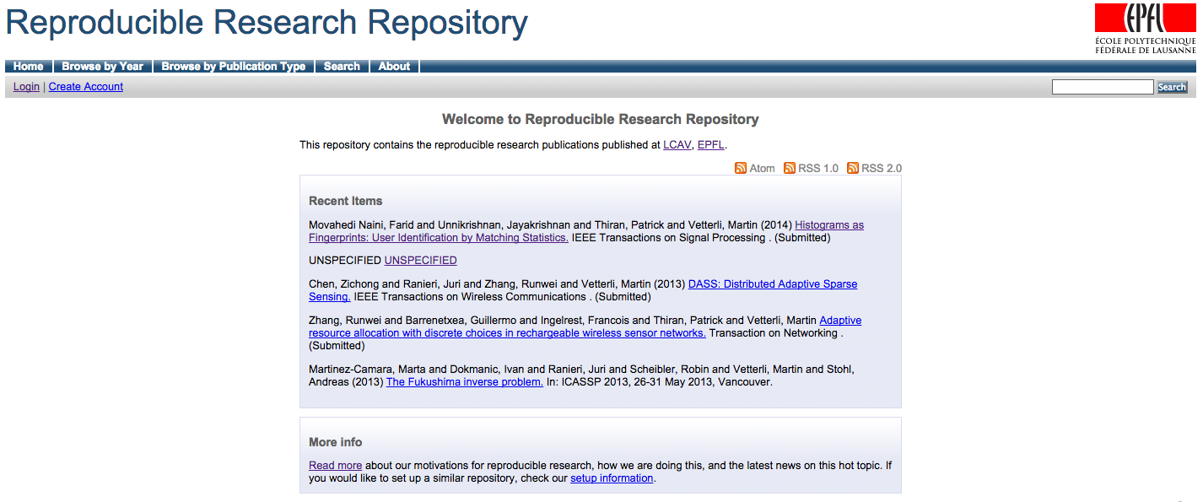
Proud History
Since 200?

Slide 34
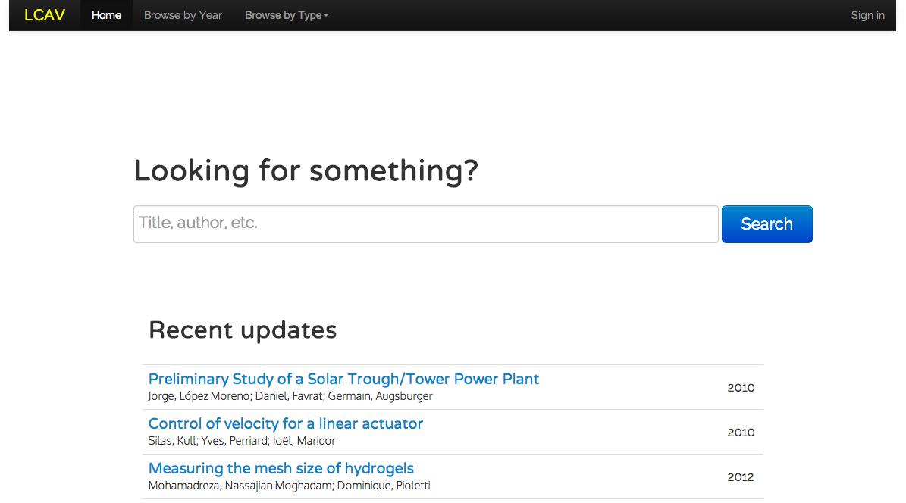
New Makeover

Slide 35

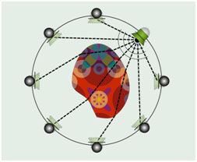
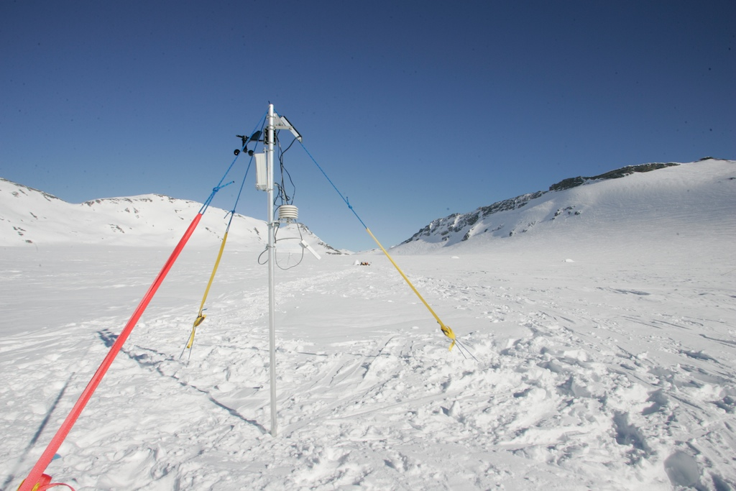




Papers + Project Papers
Lab
Projects
Papers
PDF
Code
Data
Demo

Slide 36
Conclusion

Slide 37
Study 1: Effect of Sharing Data
In a study in 2007 on microarray DNA research publications,
Papers with shared data were cited about 70% more frequently.
85 papers were studies
41 shared their data
Those 41 took 85% of the aggregate citations
Piwowar, H. a et al. Sharing detailed research data is associated with increased citation rate. PloS one. 2, (2007), 308.

Slide 38

Further Reading
http://ropensci.github.io/reproducibility-guide/sections/references/
Open Access Tutorial
Coursera Course

